Slide 1
ADAPTIVE EMAIL APPLICATION POSTALPRO
-A.ALLAN GORFOR ANANTH(715522104003)
-ASHWIN M(715522104007)
-KAVIYARASAN K(715522104028)
-THARAN ADITHYA M(715522104057)

Slide 2
DESCRIPTION
An Adaptive email application is an application which can be used to send email from their own mail to other person’s mail using their respective email address. It provides an easy and efficient way to send mail to different applications like gmail and yahoo.
Login Page: The login page is connected to database and stores login credentials created from the signup page. It stores the username and password which can be used to login into the application.
Signup Page: The signup page is used by new users to create an account to login into the application. It can be used to register the new user and giving them access to the send and see the sent mail.
Send Mail Page: The send mail page is used to send mail to an given mail address. It contains the email address, Body, and the subject . The email address will receive the body and subject sent from the applications mail address.
Sent Mail Page: The sent mail page will contain the message that has been sent through the application. It will keep track of every messages sent from the application.

Slide 3
Main Activity.java:
package com.example.emailapplication
import android.content.Context
import android.content.Intent
import android.os.Bundle
import androidx.activity.ComponentActivity
import androidx.activity.compose.setContent
import androidx.compose.foundation.Image
import androidx.compose.foundation.background
import androidx.compose.foundation.layout.*
import androidx.compose.material.*
import androidx.compose.runtime.Composable
import androidx.compose.ui.Alignment
import androidx.compose.ui.Modifier
import androidx.compose.ui.graphics.Color
import androidx.compose.ui.graphics.Shadow
import androidx.compose.ui.layout.ContentScale
import androidx.compose.ui.res.painterResource
import androidx.compose.ui.text.TextStyle
import androidx.compose.ui.text.font.FontWeight
import androidx.compose.ui.unit.dp
import androidx.compose.ui.unit.sp

Slide 4
class MainActivity : ComponentActivity() {
override fun onCreate(savedInstanceState: Bundle?) {
super.onCreate(savedInstanceState)
setContent {
Surface(
modifier = Modifier
.fillMaxSize()
.background(Color.Blue),
) {
Email(this)
}
}
}
}
@Composable
fun Email(context: Context) {
Column(
modifier = Modifier
.fillMaxSize()
.padding(horizontal = 32.dp, vertical = 48.dp),
horizontalAlignment = Alignment.CenterHorizontally,
verticalArrangement = Arrangement.Top
) {

Slide 5
Text(
text = "Emails",
color = Color.Black,
fontWeight = FontWeight.Bold,
fontSize = 36.sp,
style = TextStyle(
shadow = Shadow(
color = Color.Gray,
blurRadius = 4f
)
),
modifier = Modifier.padding(bottom = 24.dp)
)
Image(
painter = painterResource(id = R.drawable.home_screen),
contentDescription = "Home Screen Image",
contentScale = ContentScale.Crop,
modifier = Modifier
.size(180.dp)
.padding(bottom = 32.dp)
)

Slide 6
Button(
onClick = {
context.startActivity(Intent(context, SendMailActivity::class.java))
},
colors = ButtonDefaults.buttonColors(backgroundColor = Color(0xFF35fa03)),
modifier = Modifier
.fillMaxWidth(0.8f)
.padding(vertical = 8.dp),
elevation = ButtonDefaults.elevation(defaultElevation = 6.dp)
) {
Text(
text = "Send Email",
color = Color.Black,
fontSize = 18.sp,
modifier = Modifier.padding(vertical = 8.dp)
)
}
Spacer(modifier = Modifier.height(16.dp))
Button(
onClick = {
context.startActivity(Intent(context, ViewMailActivity::class.java))
},

Slide 7
colors = ButtonDefaults.buttonColors(backgroundColor = Color(0xFFfa0303)),
modifier = Modifier
.fillMaxWidth(0.8f)
.padding(vertical = 8.dp),
elevation = ButtonDefaults.elevation(defaultElevation = 6.dp)
) {
Text(
text = "Sent Emails",
color = Color.Black,
fontSize = 18.sp,
modifier = Modifier.padding(vertical = 8.dp)
)
}
}
}
AndroidManifest.xml
<?xml version="1.0" encoding="utf-8"?>
<manifest xmlns:android="http://schemas.android.com/apk/res/android"
xmlns:tools="http://schemas.android.com/tools" >
<application
android:allowBackup="true"
android:dataExtractionRules="@xml/data_extraction_rules"

Slide 8
android:fullBackupContent="@xml/backup_rules"
android:icon="@mipmap/ic_launcher"
android:label="PostalPro"
android:supportsRtl="true"
android:theme="@style/Theme.EmailApplication"
tools:targetApi="31" >
<activity
android:name=".RegisterActivity"
android:exported="false"
android:label="@string/title_activity_register"
android:theme="@style/Theme.EmailApplication" />
<activity
android:name=".MainActivity"
android:exported="false"
android:label="MainActivity"
android:theme="@style/Theme.EmailApplication" />
<activity
android:name=".ViewMailActivity"
android:exported="false"
android:label="@string/title_activity_view_mail"
android:theme="@style/Theme.EmailApplication" />
<activity
android:name=".SendMailActivity"

Slide 9
android:exported="false"
android:label="@string/title_activity_send_mail"
android:theme="@style/Theme.EmailApplication" />
<activity
android:name=".LoginActivity"
android:exported="true"
android:label="@string/app_name"
android:theme="@style/Theme.EmailApplication" >
<intent-filter>
<action android:name="android.intent.action.MAIN" />
<category android:name="android.intent.category.LAUNCHER" />
</intent-filter>
</activity>
</application>
</manifest>

Slide 10
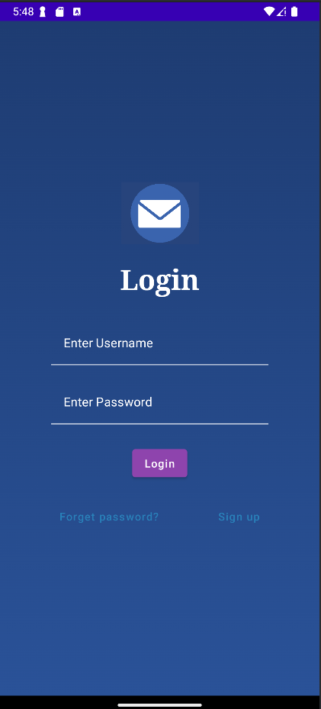
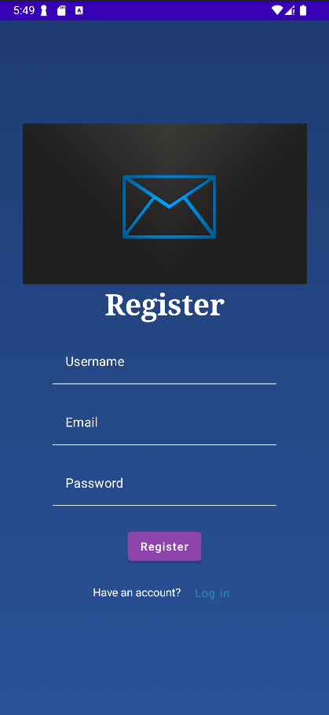
OUTPUT:

Slide 11
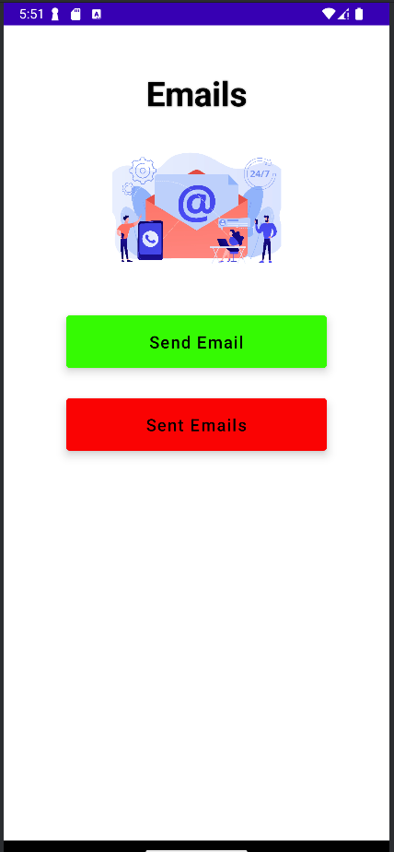
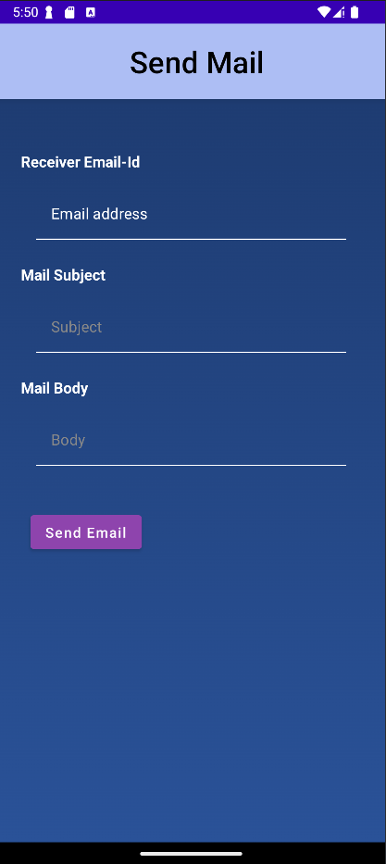

Slide 12
